Slide 1

404WEAR – Modern streetwear brand
Street
Street
Street
Stereret
Street
Street
street
PRESENTATION MADE BY
TUKENOV DANIYAR

Slide 2
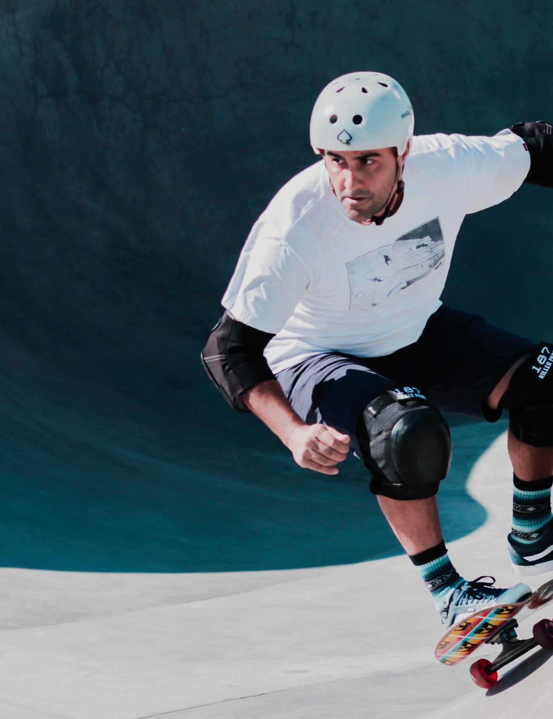
OUR MISSION
Empower individual style
Provide premium streetwear at accessible prices.

Slide 3

Product lines
• Hoodies
• T-Shirts
• Jackets
• Pants
• Accessories

Slide 4

hoodies
PERSONAL
TRAINING
PERSONAL
TRAINING
PERSONAL
TRAINING
PERSONAL
Limited editions, unique designs, high-quality materials.

Slide 5
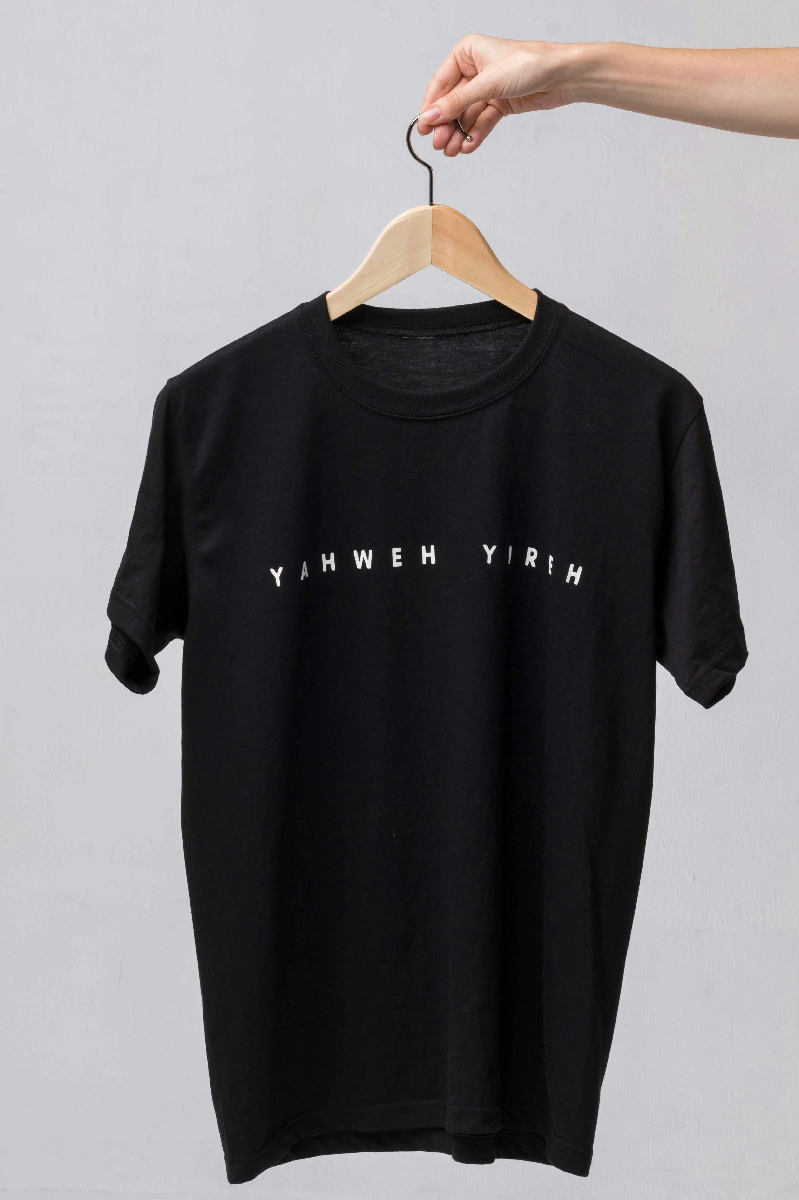
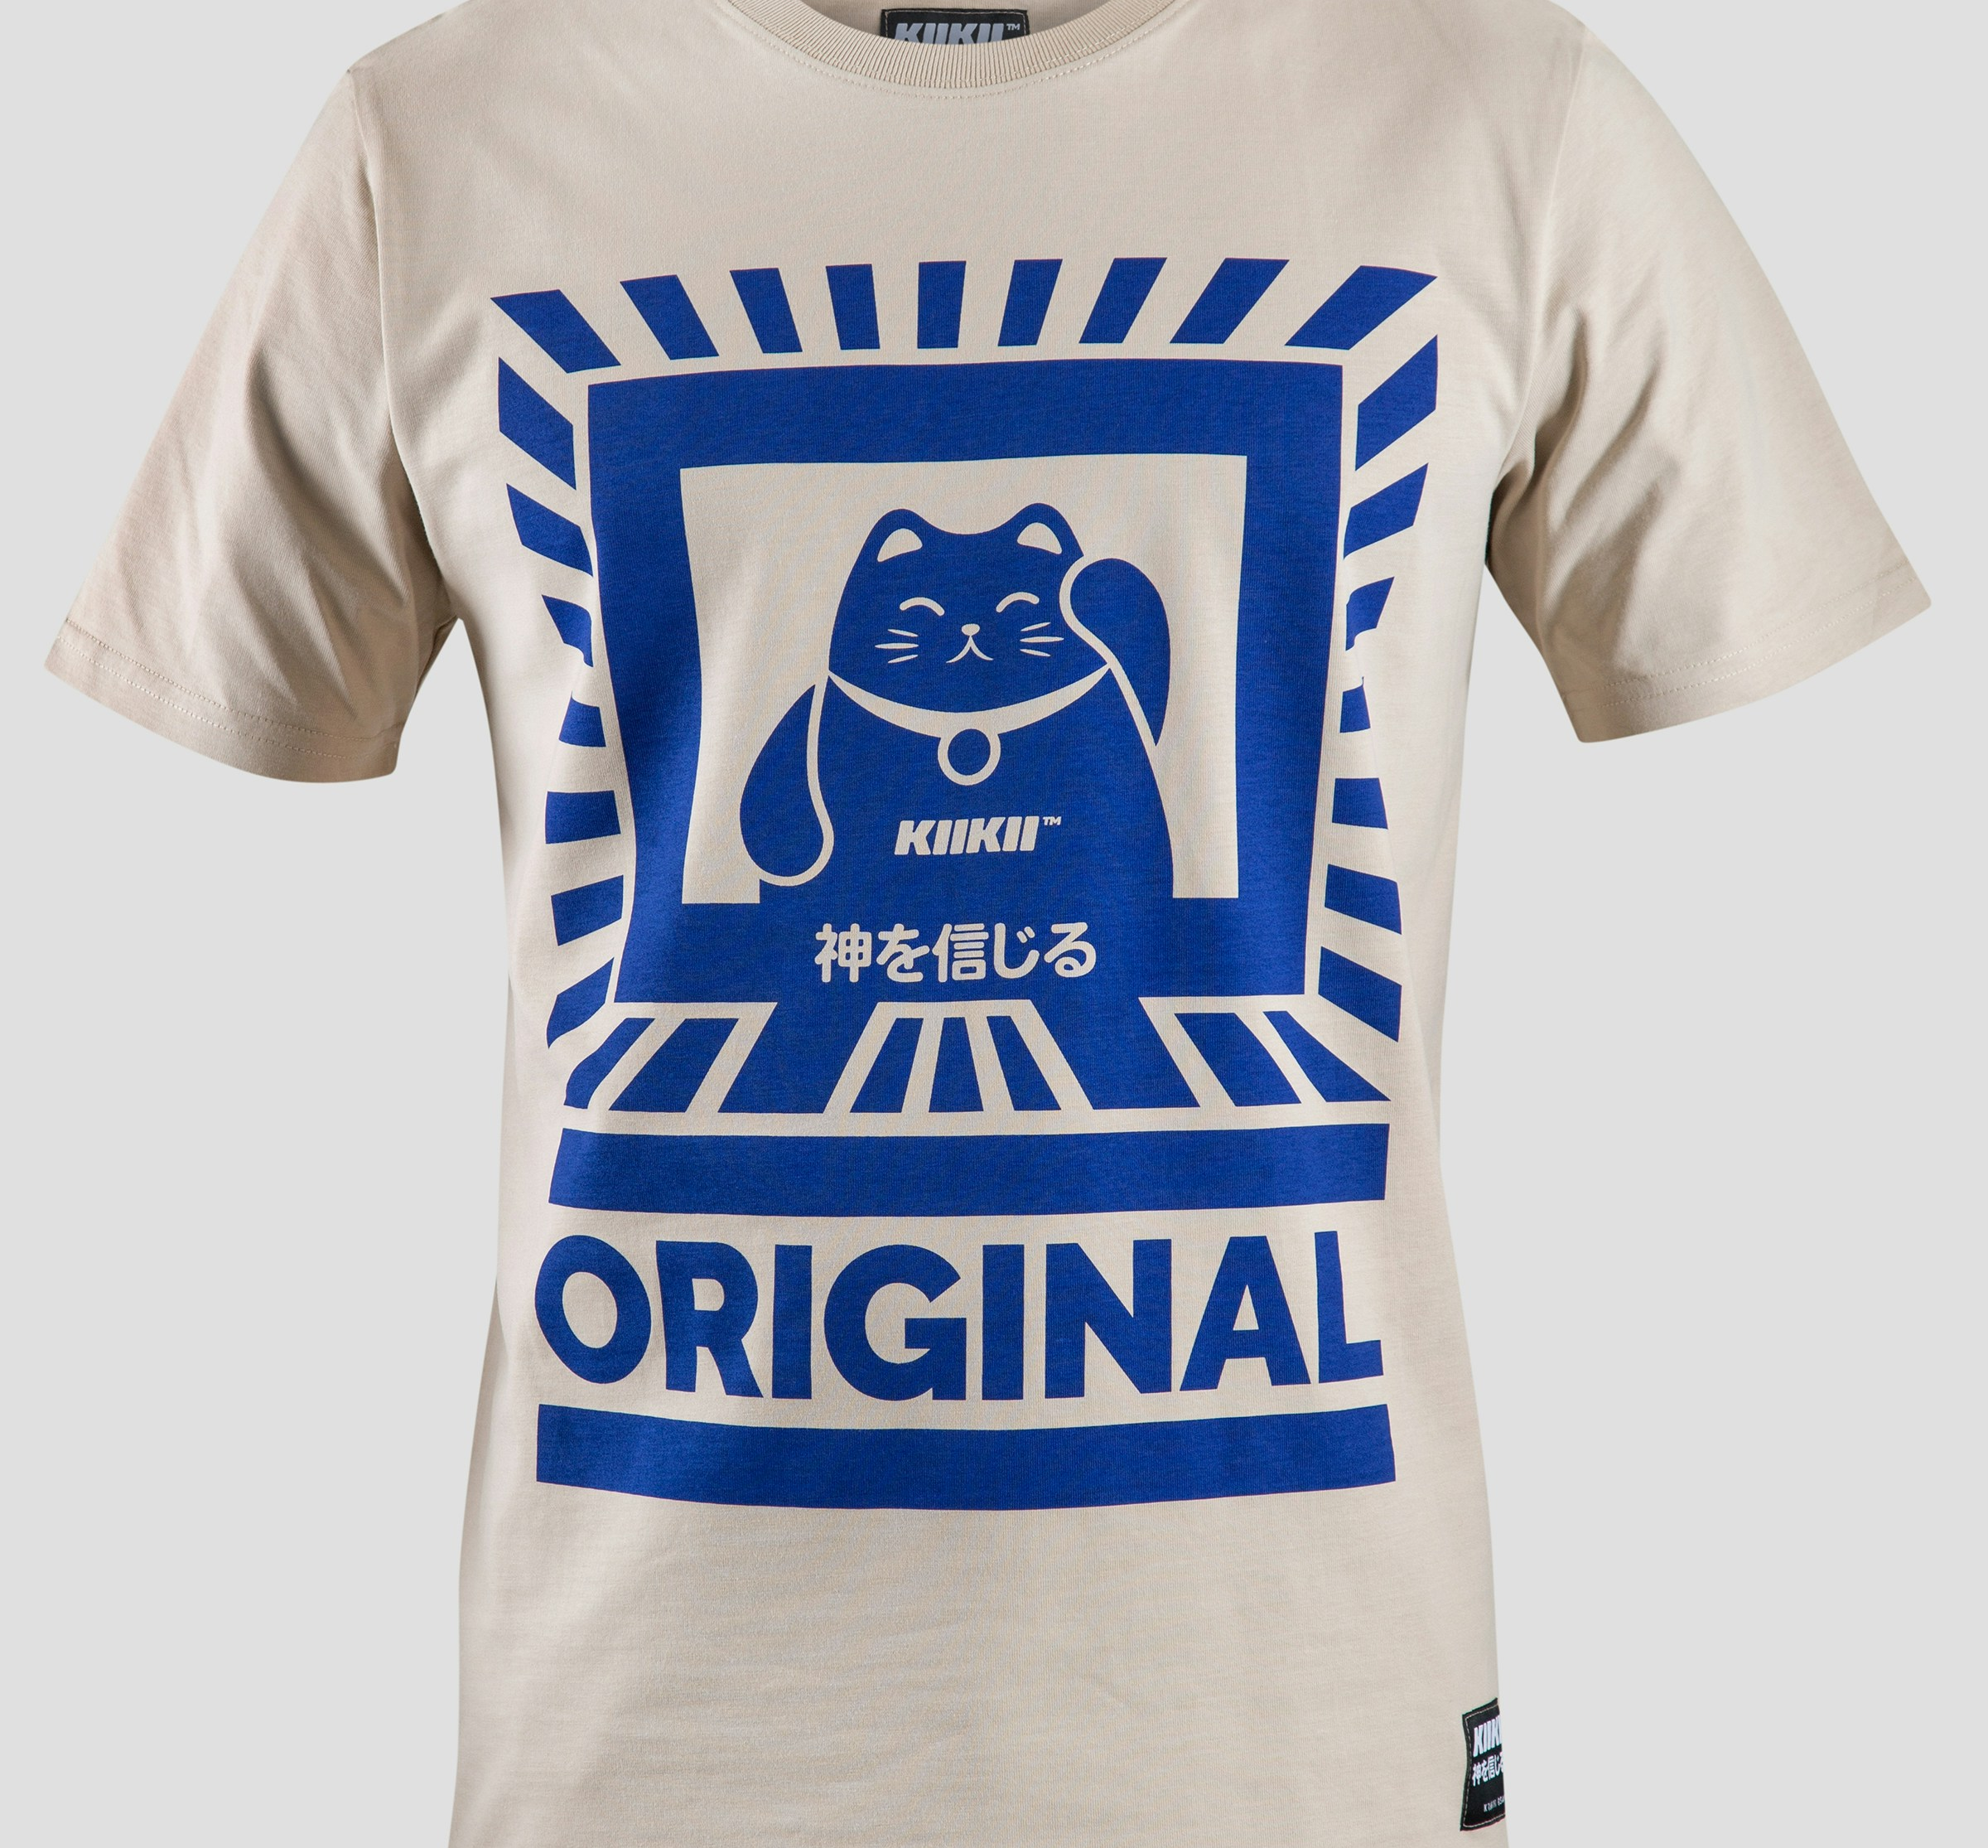
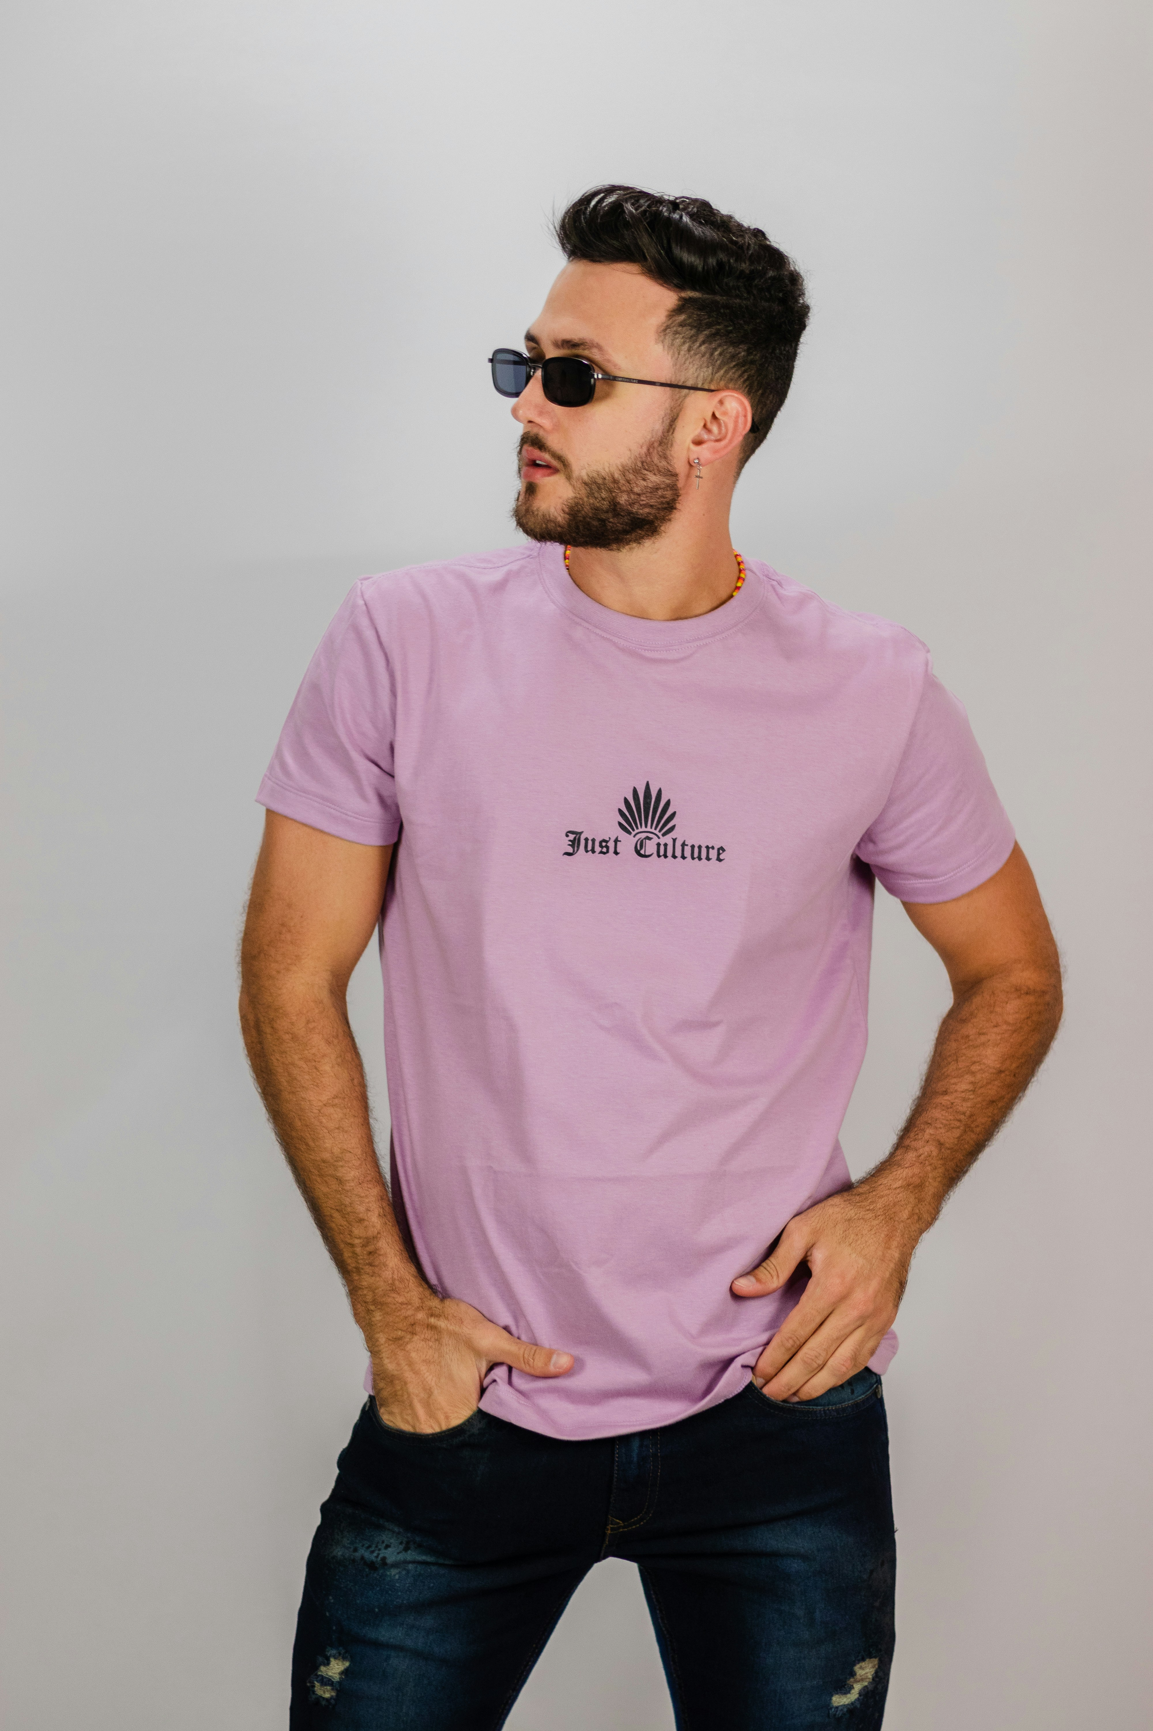
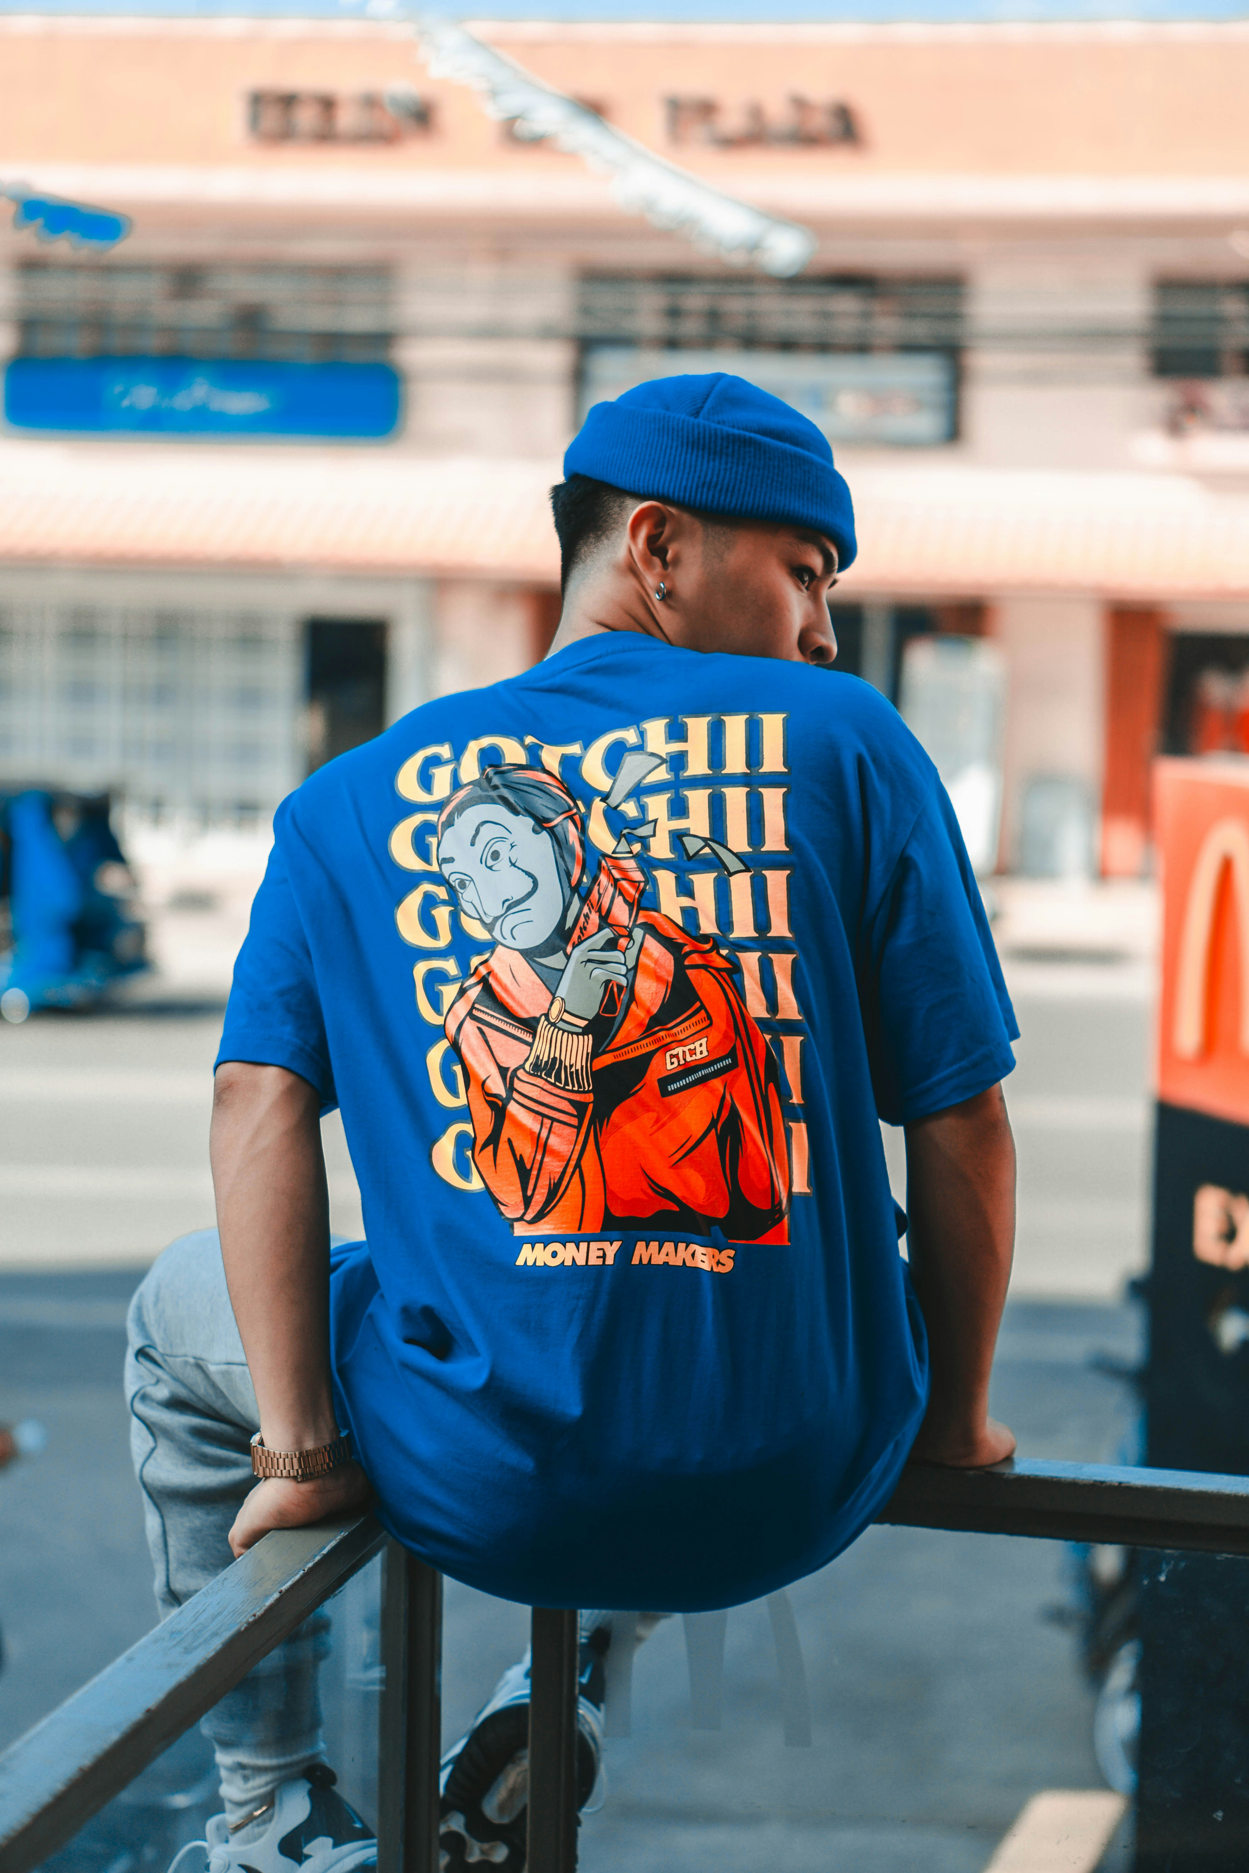
T-shirts
Graphic tees, oversized and regular fits, seasonal collections
Yahweh yireh
Kiikii original
just culture
gotchii

Slide 6

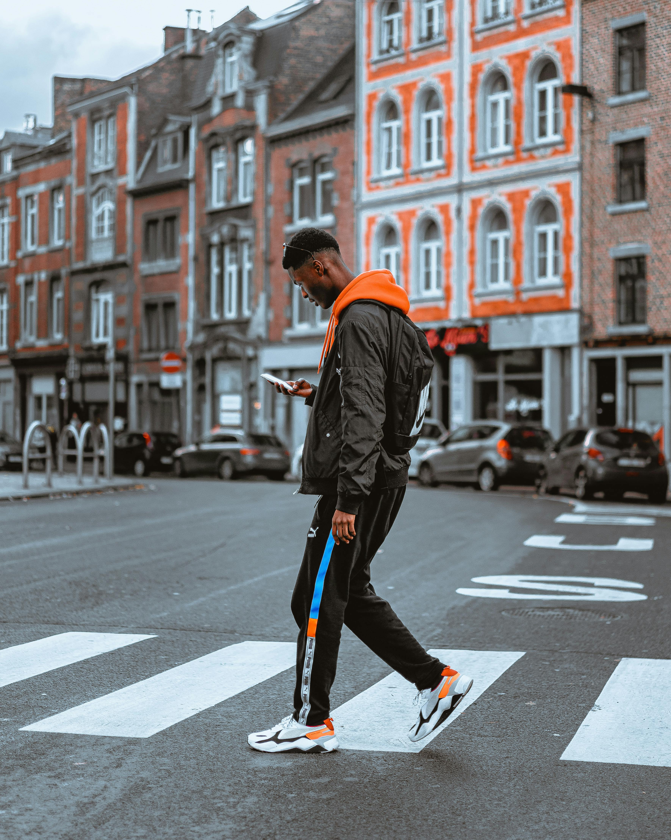



Jackets & outwear
Stylish bomber jackets, practical windbreakers.
PRIVATE
GROUP
ONLINE
HYBRID
ADD-ONS

Slide 7
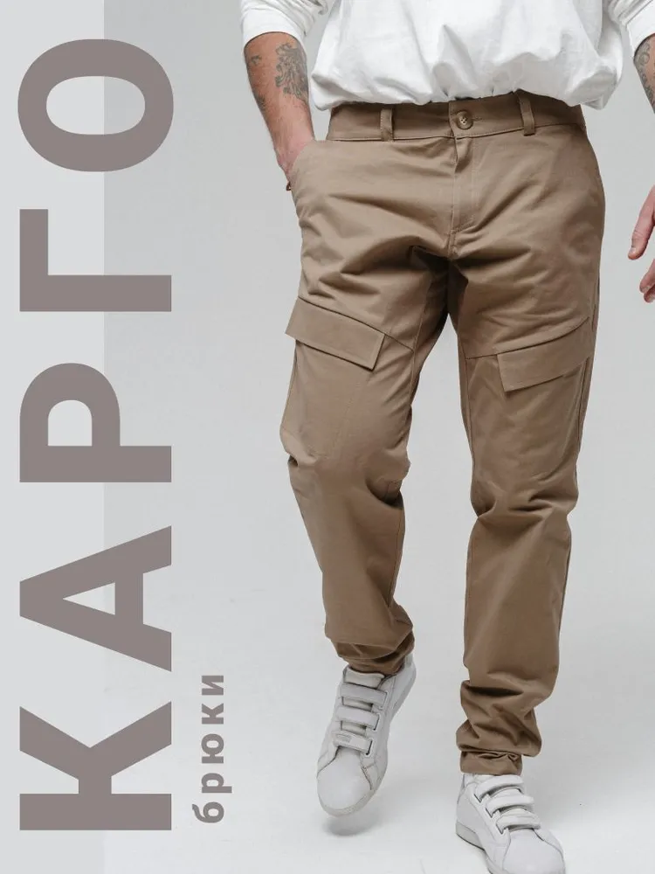
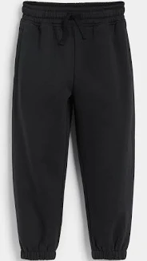
Pants collection
Cargo pants, joggers, urban-style comfort wear.
Cargo pants
joggers

Slide 8
Pricing & promotions
Competitive pricing
Seasonal discounts
Exclusive online sales
At 404WEAR, we offer premium streetwear at competitive prices, making high-quality fashion accessible to everyone.
Stay tuned for our seasonal promotions, giving you the chance to refresh your wardrobe regularly with the latest trends at great value.
Exclusive online sales: Visit our website, 404wear.com, for exclusive online deals and limited-time offers available only to our online community.

Slide 9
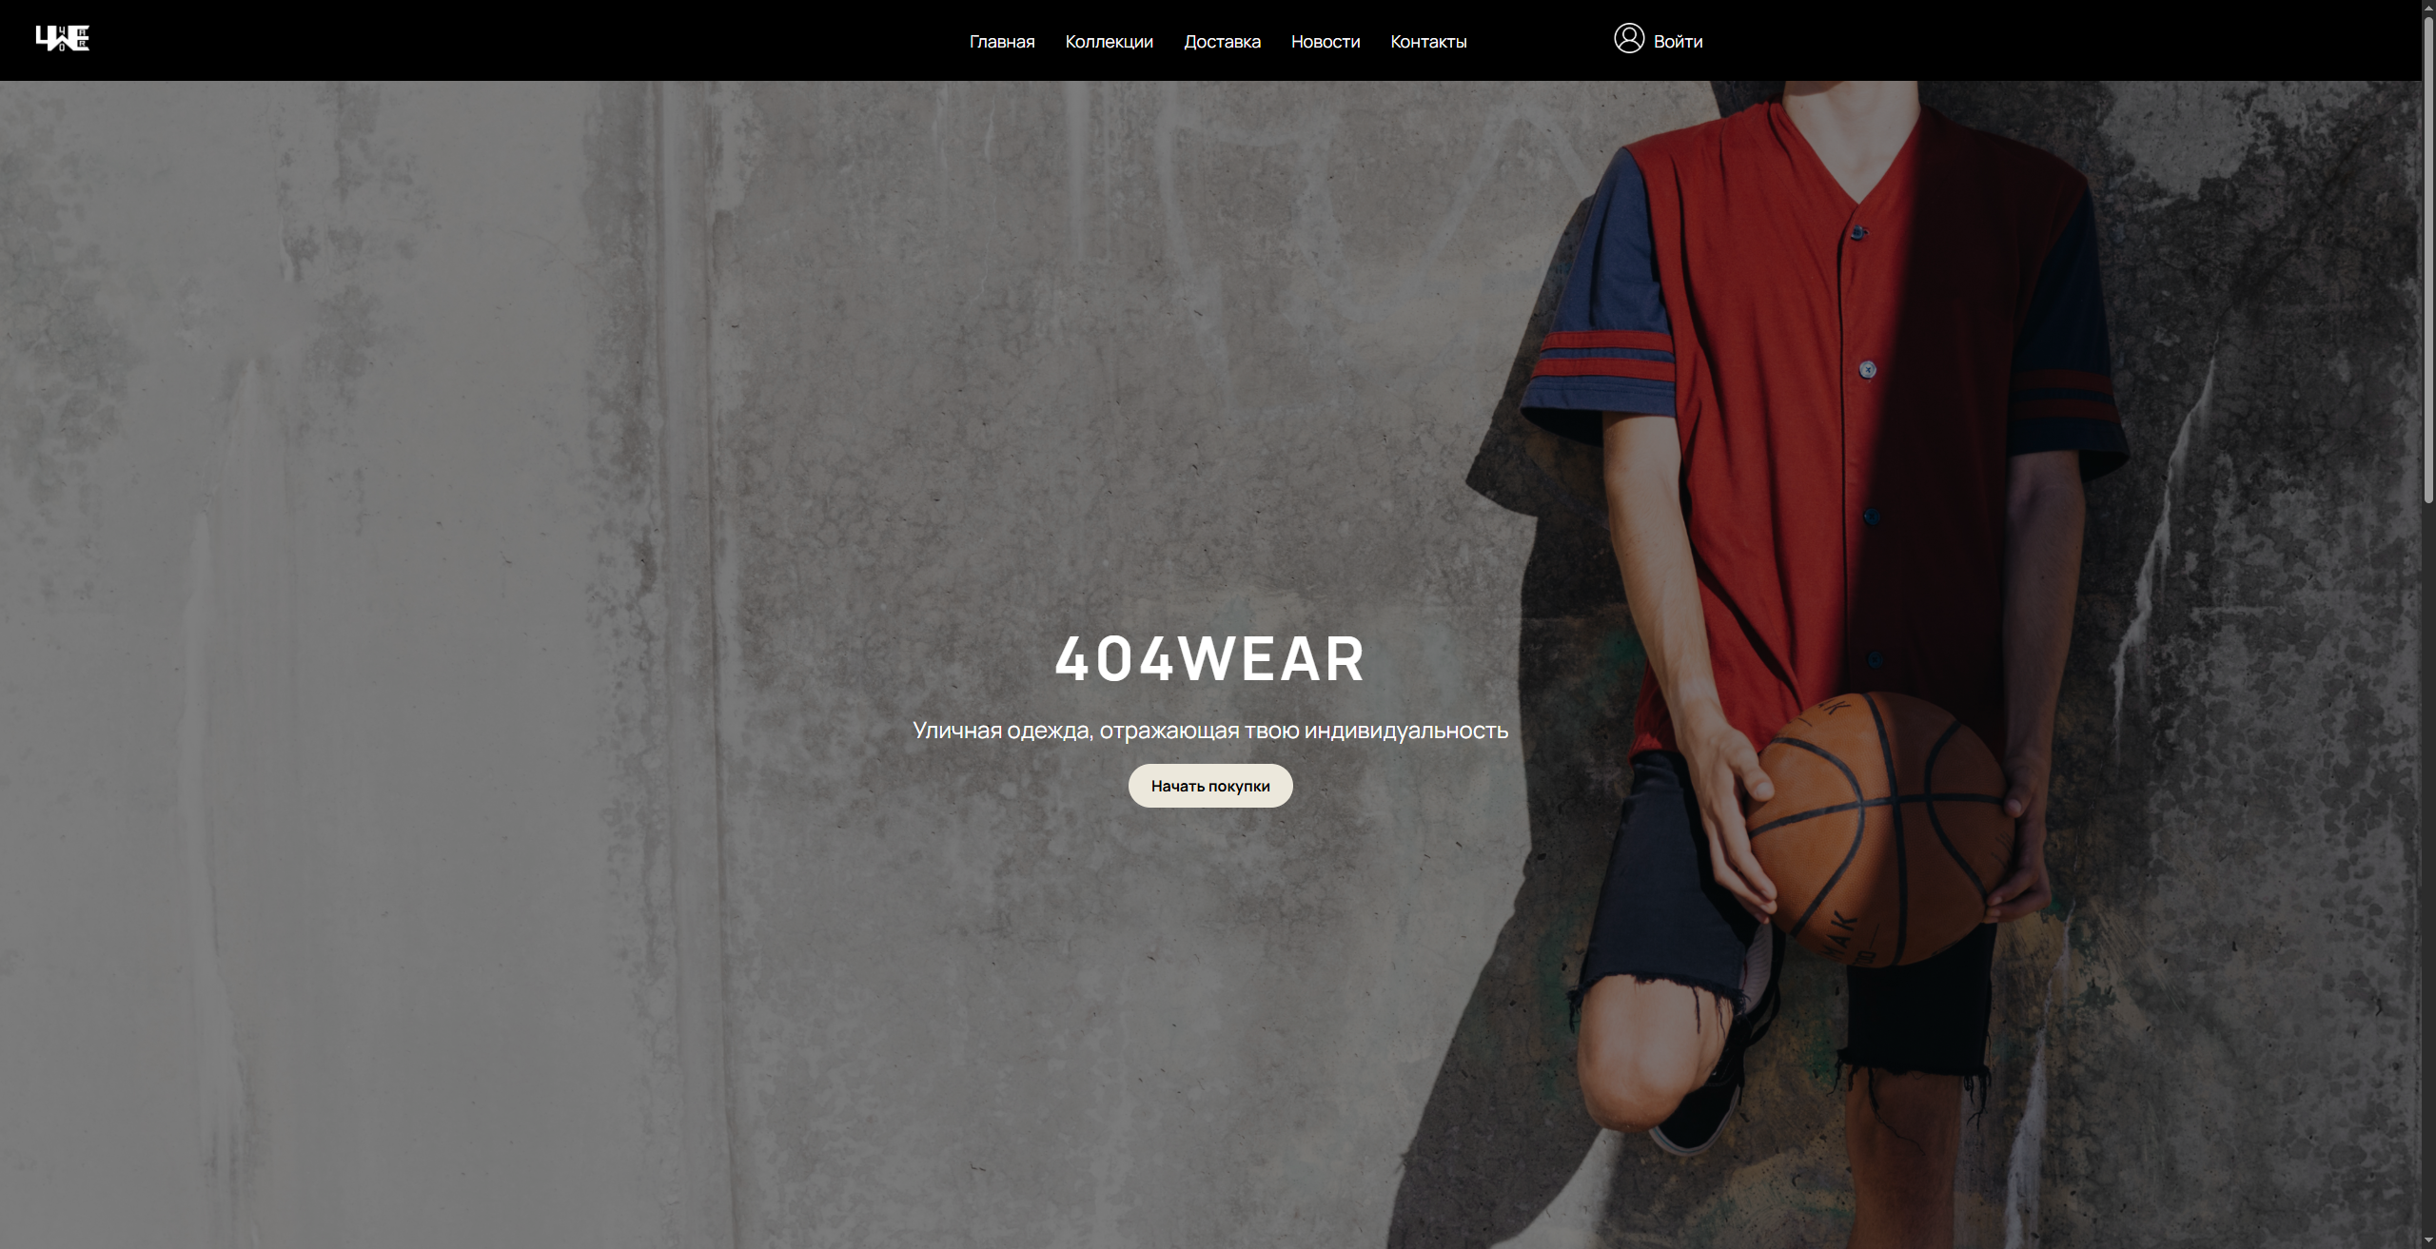
Website – www.404wear.com
404WEAR

Slide 10

THANK YOU
THANK
YOU
THANK
YOU
THANK
YOU
THANK
You can easily connect with us!
gmail - 404wear_official@gmail.COM
Website - WWW.404wear.COM

